Slide 1
Chapter 3:
Decision Structures
Starting Out with Java:
From Control Structures through Objects
Fourth Edition
by Tony Gaddis
Notes:
CHAPTER 3
Java Gaddis 4e

Slide 2
Chapter Topics
Chapter 3 discusses the following main topics:
  The if Statement
  The if-else Statement
  Nested if statements
  The if-else-if Statement
  Logical Operators
  Comparing String Objects
3-<number>
Notes:
CHAPTER 3
Java Gaddis 4e

Slide 3
Chapter Topics
Chapter 3 discusses the following main topics:
  More about Variable Declaration and Scope
  The Conditional Operator
  The switch Statement
  The DecimalFormat Class
  The printf Method
3-<number>
Notes:
CHAPTER 3
Java Gaddis 4e

Slide 4
The if Statement
The if statement decides whether a section of code executes or not.
The if statement uses a boolean to decide whether the next statement or block of statements executes.
  if (boolean expression is true)
  execute next statement.
3-<number>
Notes:
CHAPTER 3
Java Gaddis 4e

Slide 5
Flowcharts
if statements can be modeled as a flow chart.
Is it cold
outside?
Yes
Wear a coat.
3-<number>

Slide 6
Flowcharts
A more complicated if statement may be modeled as:
Is it cold
outside?
Yes
Wear a coat.
Wear a hat.
Wear gloves.
3-<number>

Slide 7
Relational Operators
The conditions used within if statements are usually formed by using relational operators.
Relational Operator | Meaning
> | is greater than
< | is less than
>= | is greater than or equal to
<= | is less than or equal to
== | is equal to
!= | is not equal to
3-<number>
Notes:
CHAPTER 3
Java Gaddis 4e

Slide 8
Boolean Expressions
When relational operators are used to express a condition, a boolean expression is created.
Boolean expressions result in a true or false condition.
Expression | Meaning
x > y | Is x greater than y?
x < y | Is x less than y?
x >= y | Is x greater than or equal to y?
x <= y | Is x less than or equal to y.
x == y | Is x equal to y?
x != y | Is x not equal to y?
3-<number>
Notes:
CHAPTER 3
Java Gaddis 4e

Slide 9
if Statement
The if statement syntax is:
if (boolean expression)
statement;
Notice that the body of the if statement is one statement.
if (x > y)
  System.out.println("X is greater than Y");
if(x == y)
  System.out.println("X is equal to Y");
Example: AverageScore.java
3-<number>
Notes:
CHAPTER 3
Java Gaddis 4e

Slide 10
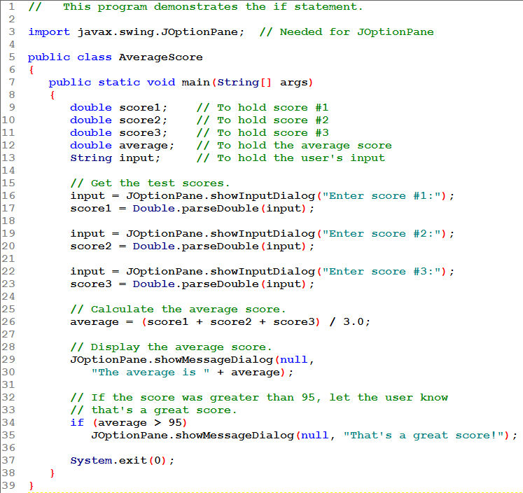
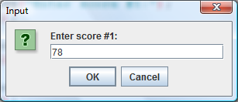
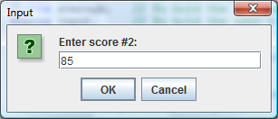

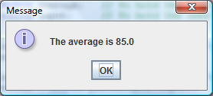

Slide 11
Block if Statements
What if you need to put multiple statements into the body of an if statement? Create a block by using curly braces {} to enclose them.
  Any time braces are used to create a block, that block is regarded as one statement!
If curly braces are used to group conditionally executed statements, the if statement is ended by the closing curly brace.
  if (boolean expression)
  {
  statement1;
  statement2;
  }
Curly brace ends the statement.
3-<number>

Slide 12
Block if Statements
Remember that when the curly braces are not used, then only the next statement after the if condition will be executed conditionally.
  if (boolean expression)
  statement1;
  statement2;
  statement3;
Only this statement is conditionally executed.
3-<number>
Notes:
CHAPTER 3
Java Gaddis 4e

Slide 13
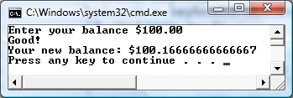
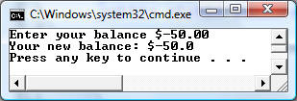
Block if Statements
  System.out.println("Enter your balance $");
  balance = keyboard.nextDouble();
  if (balance >= 0)
  {
  System.out.println( "Good!" );
  balance += (INTEREST_RATE * balance) / 12;
  }
  System.out.println("Your new balance: $" + balance);

Slide 14
if-else Statement Flowcharts
No
Yes
Is it cold
outside?
Wear shorts.
Wear a coat.
3-<number>

Slide 15
if-else Statements
The if-else statement adds the ability to conditionally execute code when the if condition is false.
  if (boolean expression)
  statementOrBlockIfTrue;
  else
  statementOrBlockIfFalse;
See example: Division.java
3-<number>
Notes:
CHAPTER 3
Java Gaddis 4e

Slide 16
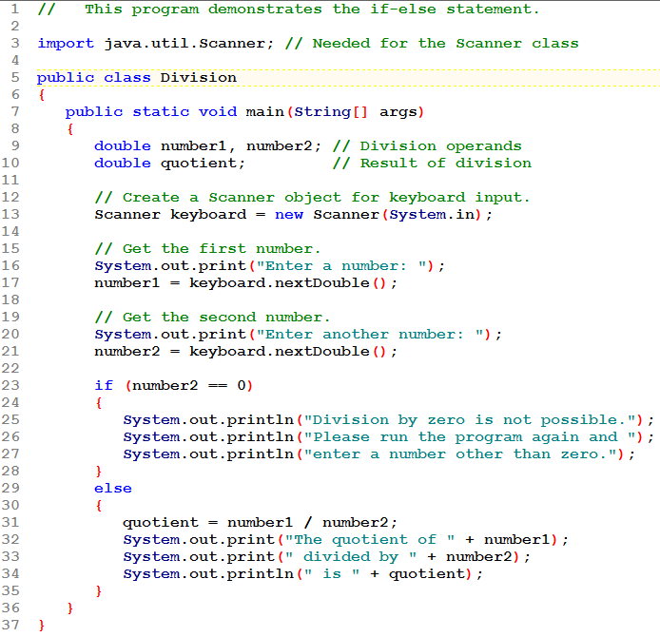
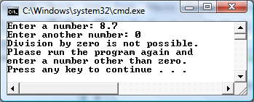
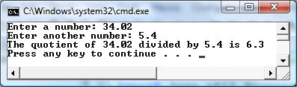

Slide 17
Programming Style and if Statements
Rules of thumb:
  The conditionally executed statement should be on the line after the if condition.
  The conditionally executed statement should be indented one level from the if condition.
  If an if statement does not have the block curly braces, it is ended by the first semicolon encountered after the if condition.
    if (expression)
    statement;
No semicolon here.
Semicolon ends statement here.
3-<number>
Notes:
CHAPTER 3
Java Gaddis 4e

Slide 18
Flags
A flag is a boolean variable that monitors some condition in a program.
When a condition is true, the flag is set to true.
The flag can be tested to see if the condition has changed. In this example, highScore is a flag.
  if (average > 95)
  highScore = true;
  OR
  highScore = average > 95;
Later, this condition can be tested:
  if (highScore)
  System.out.println("That′s a high score!");
3-<number>
Notes:
CHAPTER 3
Java Gaddis 4e

Slide 19
Comparing Characters
Characters can be tested with relational operators.
Characters are stored in memory using the Unicode character format.
Unicode is stored as a sixteen (16) bit number.
Characters are ordinal, meaning they have an order in the Unicode character set.
Since characters are ordinal, they can be compared to each other.
  char c;
  // code here to read c
  if(c < ′Z′)
  System.out.println(c + " is less than Z");
3-<number>
Notes:
CHAPTER 3
Java Gaddis 4e

Slide 20
Nested if Statements
An if-else statement can contain any sort of statement within it.
In particular, it can contain another if-else statement.
  An if-else may be nested within the "if" part.
  An if-else may be nested within the "else" part.
  An if-else may be nested within both parts.
The nested if is executed only if the outer if statement results in a true condition.
3-<number>
Notes:
CHAPTER 3
Java Gaddis 4e

Slide 21
Nested if Statement Flowcharts
No
Yes
Is it cold
outside?
Wear shorts.
No
Is it
snowing?
Yes
Wear a jacket.
Wear a parka.
3-<number>

Slide 22
Nested if Statements
if (coldOutside)
{
if (snowing)
{
wearParka();
}
else
{
wearJacket();
}
}
else
{
wearShorts();
}
3-<number>
Notes:
CHAPTER 3
Java Gaddis 4e

Slide 23
if-else Matching
Curly brace use is not required if there is only one statement to be conditionally executed.
However, sometimes curly braces can help make the program more readable.
Additionally, proper indentation makes it much easier to match up else statements with their corresponding if statement.
3-<number>
Notes:
CHAPTER 3
Java Gaddis 4e

Slide 24
Alignment and Nested if Statements
if (coldOutside)
{
if (snowing)
{
wearParka();
}
else
{
wearJacket();
}
}
else
{
wearShorts();
}
This if and else
go together.
This if and else
go together.
Line up matching if/else.
Indent within the if part and also within the else part.
3-<number>
Notes:
CHAPTER 3
Java Gaddis 4e

Slide 25
Alignment and Nested if Statements
if (coldOutside)
{
if (snowing)
{
wearParka();
}
else
{
wearJacket();
}
}
else
{
wearShorts();
}
Which braces are needed?
3-<number>
Notes:
CHAPTER 3
Java Gaddis 4e

Slide 26
Alignment and Nested if Statements
if (coldOutside)
if (snowing)
wearParka();
else
wearJacket();
else
wearShorts();
Which braces are needed?
NONE! There is exactly one statement inside the if and the else parts here.
Some consider that the use of braces on the previous version makes it more easily understood.
This is ONE statement!
3-<number>
Notes:
CHAPTER 3
Java Gaddis 4e

Slide 27
Nested if Statements
See example: LoanQualifier.java
3-<number>
Notes:
CHAPTER 3
Java Gaddis 4e

Slide 28
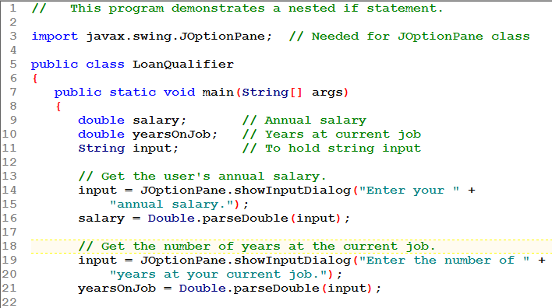
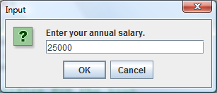
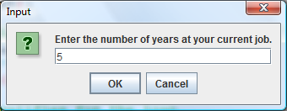

Slide 29
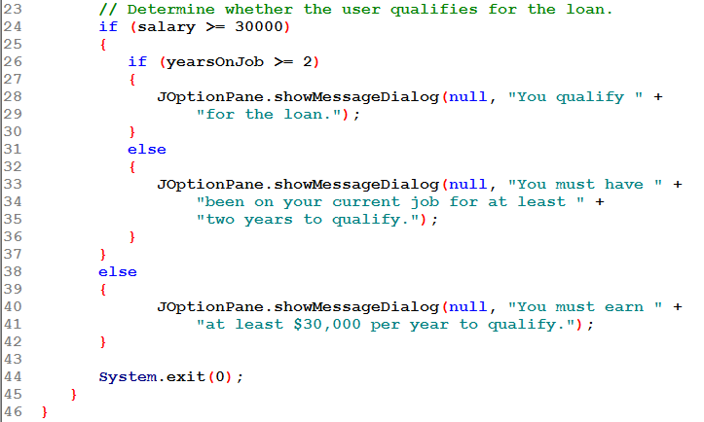
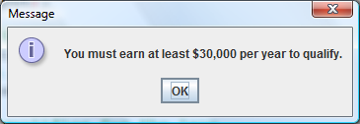

Slide 30
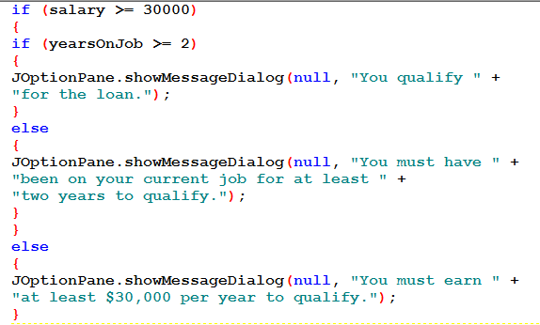
Nested if Statements: Indent Properly
Do NOT write code like this!
3-<number>
Notes:
CHAPTER 3
Java Gaddis 4e

Slide 31
Nested Statements
Each else is paired with the nearest unmatched if.
First Form
if (a > b)
if (c > d)
e = f;
else
g = h;

Slide 32
Nested Statements
Each else is paired with the nearest unmatched if.
First Form
if (a > b)
if (c > d)
e = f;
else
g = h;
// OOPS
Second Form
if (a > b)
{
if (c > d)
e = f;
}
else
g = h;
else matches second if
else matches first if

Slide 33
Testing a Series of Conditions
Grading scheme:
  A 90 and above
  B 80 – 89
  C 70 – 79
  D 60 – 69
  F below 60
We want a program to read a score and output the correct grade.
Notes:
CHAPTER 3
Java Gaddis 4e

Slide 34
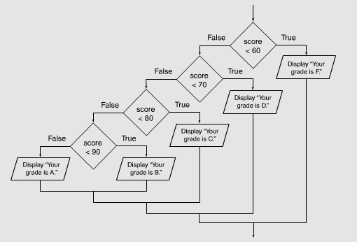
Testing a Series of Conditions
Flowchart:
Notes:
CHAPTER 3
Java Gaddis 4e

Slide 35
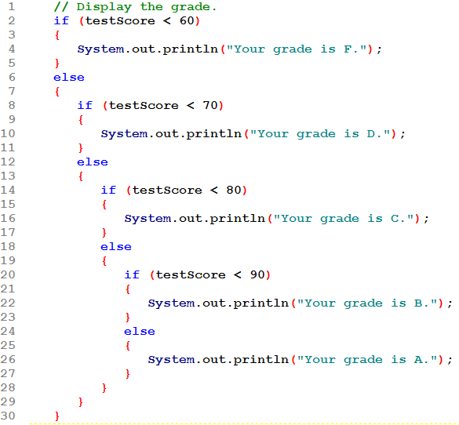
Testing a Series of Conditions
Nested if tests:
See how this code "stair-steps". With many possibilities this code could march right off the page!
Notes:
CHAPTER 3
Java Gaddis 4e

Slide 36
The if/else if Statement
Tests a series of conditions until one is found to be true
Often simpler than using nested if/else statements
Can be used to model thought processes such as:
"If it is raining, take an umbrella,
else, if it is windy, take a hat,
else, take sunglasses”

Slide 37
if/else if Statements
if (expression_1)
{
statement;
statement;
etc.
}
else if (expression_2)
{
statement;
statement;
etc.
}
Insert as many else if clauses as necessary
else
{
statement;
statement;
etc.
}
If expression_1 is true these statements are executed, and the rest of the structure is ignored.
Otherwise, if expression_2 is true these statements are executed, and the rest of the structure is ignored.
The TRAILING ELSE
This trailing else catches invalid test scores
These statements are executed if none of the expressions above are true.
See example: TestResults.java
3-<number>
Notes:
CHAPTER 3
Java Gaddis 4e

Slide 38
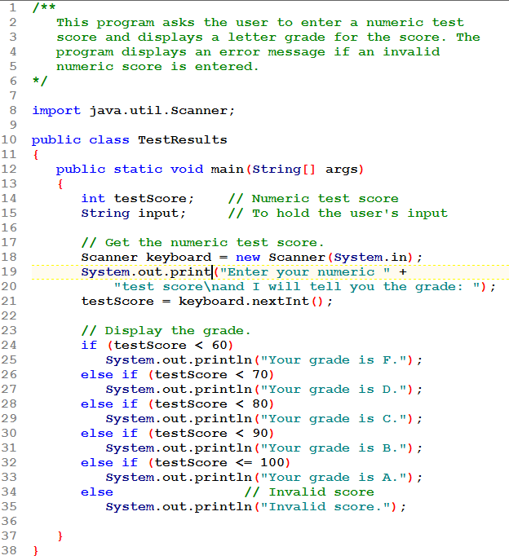
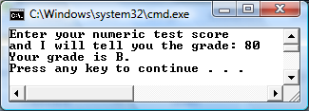
This trailing else catches invalid test scores

Slide 39
The if/else if Statement
This is really not a new statement, but just a reformatting of the if/else statement.
Its main benefit is readability: code won't stair-step across the page.
It can be used whenever there are mutually exclusive conditions, exactly one of which is to be acted upon.

Slide 40
STACKING VS NESTING
Problem:
Application Requirements
A menu displays 3 choices: 1 (add), 2 (subtract), 3 (multiply). After reading the user’s choice perform the appropriate operation on variables x and y, giving a value to variable z.
Notes:
Java Gaddis 4e
CHAPTER 3

Slide 41
STACKED SOLUTION
if ( choice == 1 )
{
z = x + y;
}
if ( choice == 2 )
{
z = x - y;
}
if ( choice == 3 )
{
z = x * y;
}
COMMENTS:
  how many times will each test execute if this code is embedded in a loop that runs 100 times?
  how can we modify this code to display a message when the choice is not valid?
Notes:
Java Gaddis 4e
CHAPTER 3

Slide 42
STACKED SOLUTION
if ( choice == 1 )
{
z = x + y;
}
if ( choice == 2 )
{
z = x - y;
}
if ( choice == 3 )
{
z = x * y;
}
COMMENTS:
  how many times will each test execute if this code is embedded in a loop that runs 100 times?
  100 for each!
  how can we modify this code to display a message when the choice is not valid?
  Requires an elaborate solution using ands/ors. Not effective.
Notes:
Java Gaddis 4e
CHAPTER 3

Slide 43
NESTED SOLUTION, ver 1
if ( choice == 1 )
{
z = x + y;
}
else
if ( choice == 2 )
{
z = x - y;
}
else
if ( choice == 3 )
{
z = x * y;
}
COMMENTS:
  how many times will each test execute if this code is embedded in a loop that runs 100 times?
  how can we modify this code to display a message when the choice is not valid?
Notes:
Java Gaddis 4e
CHAPTER 3

Slide 44
NESTED SOLUTION, ver 1
if ( choice == 1 )
{
z = x + y;
}
else
if ( choice == 2 )
{
z = x - y;
}
else
if ( choice == 3 )
{
z = x * y;
}
COMMENTS:
  how many times will each test execute if this code is embedded in a loop that runs 100 times? 100 for the first test. Each following test only executes if the previous one is false.
  how can we modify this code to display a message when the choice is not valid? Add an else to the last if. See next slide.
Notes:
Java Gaddis 4e
CHAPTER 3

Slide 45
NESTED SOLUTION, ver 2
if ( choice == 1 )
{
z = x + y;
}
else if ( choice == 2 )
{
z = x - y;
}
else if ( choice == 3 )
{
z = x * y;
}
else
{
// error message
}
COMMENTS:
  we have formed an "else if" by following an else immediately with an if. Still need a space between them.
  no more "stair steps"
  use this style when you are testing mutually exclusive conditions (i.e. only one can be true)
Notes:
Java Gaddis 4e
CHAPTER 3

Slide 46
Logical Operators
Java provides two binary logical operators (&& and ||) that are used to combine boolean expressions.
Java also provides one unary logical operator
( ! ) to reverse the truth of a boolean expression.
3-<number>
Notes:
CHAPTER 3
Java Gaddis 4e

Slide 47
Logical Operators
Operator | Meaning | Effect
! | NOT | The ! operator reverses the truth of a boolean expression. If it is applied to an expression that is true, the operator returns false. If it is applied to an expression that is false, the operator returns true.
&& | AND | Connects two boolean expressions into one. Both expressions must be true for the overall expression to be true.
|| | OR | Connects two boolean expressions into one. One or both expressions must be true for the overall expression to be true. It is only necessary for one to be true, and it does not matter which one.
3-<number>
Notes:
CHAPTER 3
Java Gaddis 4e

Slide 48
The ! Operator
The ! operator performs a logical NOT operation.
If an expression is true, !expression will be false.
  if (!(temperature > 100))
  System.out.println("Below the maximum temp.");
If temperature > 100 evaluates to false, then the output statement will be run.
Expression 1 | !Expression1
true | false
false | true
3-<number>
Notes:
CHAPTER 3
Java Gaddis 4e

Slide 49
The && Operator
The logical AND operator (&&) takes two operands that must both be boolean expressions.
The resulting combined expression is true if (and only if) both operands are true.
Expression 1 | Expression 2 | Expression1 && Expression2
true | true | true
false | true | false
true | false | false
false | false | false
3-<number>
Notes:
CHAPTER 3
Java Gaddis 4e

Slide 50
The || Operator
The logical OR operator (||) takes two operands that must both be boolean expressions.
The resulting combined expression is false if (and only if) both operands are false.
Expression 1 | Expression 2 | Expression1 || Expression2
true | true | true
false | true | true
true | false | true
false | false | false
3-<number>
Notes:
CHAPTER 3
Java Gaddis 4e

Slide 51
Short Circuiting
Logical AND and logical OR operations perform short-circuit evaluation of expressions.
Logical AND will evaluate to false as soon as it sees that one of its operands is a false expression.
Logical OR will evaluate to true as soon as it sees that one of its operands is a true expression.
3-<number>
Notes:
CHAPTER 3
Java Gaddis 4e

Slide 52
Logical Operators - examples
int x = 12, y = 5, z = -4;
(x > y) && (y > z)
(x > y) && (z > y)
(x <= z) || (y == z)
(x <= z) || (y != z)
!(x >= z)
Notes:
CHAPTER 3
Java Gaddis 4e

Slide 53
Logical Operators - examples
int x = 12, y = 5, z = -4;
(x > y) && (y > z) | true
(x > y) && (z > y) | false
(x <= z) || (y == z) | false
(x <= z) || (y != z) | true
!(x >= z) | false
Notes:
CHAPTER 3
Java Gaddis 4e

Slide 54
Using the Truth Tables
To receive a bonus, a salesperson must be rated A and he/she must sell more than $10,000 in product
  ___________________________________
To send a letter to all A-rated salespeople and all B-rated salespeople
  ___________________________________

Slide 55
Using the Truth Tables
To receive a bonus, a salesperson must be rated A and he/she must sell more than $10,000 in product
  rating == 'A' && sales > 10000
To send a letter to all A-rated salespeople and all B-rated salespeople
  rating == 'A' || rating == 'B'

Slide 56
Order of Precedence
The ! operator has a higher order of precedence than the && and || operators.
The && and || operators have a lower precedence than arithmetic operators and relational operators like < and >.
Parenthesis can be used to force the precedence to be changed.
3-<number>
Notes:
CHAPTER 3
Java Gaddis 4e

Slide 57
Order of Precedence
Order of Precedence | Operators | Description
1 | (unary negation) ! | Unary negation, logical NOT
2 | * / % | Multiplication, Division, Modulus
3 | + - | Addition, Subtraction
4 | < > <= >= | Less-than, Greater-than, Less-than or equal to, Greater-than or equal to
5 | == != | Is equal to, Is not equal to
6 | && | Logical AND
7 | || | Logical NOT
8 | = += -= *= /= %= | Assignment and combined assignment operators.
3-<number>
Notes:
CHAPTER 3
Java Gaddis 4e

Slide 58
LOGICAL OPERATORS
Exercises: Evaluate each of these expressions:
int x = 10, y = 3, z = 8;
x < 5 || y > 2 ___________
!(z <= 8 ) ___________
y + 5 < x || !(z > 4) && x – 3 < 5
___________
Notes:
Java Gaddis 4e
CHAPTER 3

Slide 59
LOGICAL OPERATORS
Exercises: Evaluate each of these expressions:
int x = 10, y = 3, z = 8;
x < 5 || y > 2 f || t → true
!(z <= 8 ) !( t ) → false
y + 5 < x || !(z > 4) && x – 3 < 5
t || f && f →
t || f → true
Notes:
Java Gaddis 4e
CHAPTER 3

Slide 60
Checking Numeric Ranges with Logical Operators
Used to test to see if a value falls inside a range:
  if (grade >= 0 && grade <= 100)
  System.out.println("Valid grade");
Can also test to see if value falls outside of range:
  if (grade <= 0 || grade >= 100)
  System.out.println("Invalid grade");
Cannot use mathematical notation:
  if (0 <= grade <= 100) //doesn’t work!

Slide 61
LOGICAL OPERATORS
Exercises
  Write an if test that will be TRUE when x is in the range 15 – 70 (inclusive).
    if ( ? ) …
    if (________________________________) …
  Write an if test that will be TRUE for balances less than 0 as well as for balances over 5000.
    if ( ? ) …
    if (________________________________) …
Notes:
Java Gaddis 4e
CHAPTER 3

Slide 62
LOGICAL OPERATORS
Exercises
  Write an if test that will be TRUE when x is in the range 15 – 70 (inclusive).
    if ( ? ) …
    if ( x >= 15 && x <= 70 ) …
  Write an if test that will be TRUE for balances less than 0 as well as for balances over 5000.
    if ( ? ) …
    if ( balance < 0 || balance > 5000 ) …
Notes:
Java Gaddis 4e
CHAPTER 3

Slide 63
LOGICAL OPERATORS
Exercises
  Your boss wants a letter to go out to types 1 and 2 customers, who also have a balance over $5,000.
    if ( ? ) send_a_letter;
Notes:
Java Gaddis 4e
CHAPTER 3

Slide 64
LOGICAL OPERATORS
Exercises
  Your boss wants a letter to go out to types 1 and 2 customers, who also have a balance over $5,000.
    if ( ? ) send_a_letter;
    if ( ( type == 1 || type == 2 ) &&
    balance > 5000 ) …
      parentheses are needed because of precedence
Notes:
Java Gaddis 4e
CHAPTER 3

Slide 65
LOGICAL OPERATORS
Exercises
  Your boss made a mistake yesterday. Now you have to send a letter to everyone who didn't get the original one.
    if ( ? ) send_another_letter;
Notes:
Java Gaddis 4e
CHAPTER 3

Slide 66
LOGICAL OPERATORS
Exercises
  Your boss made a mistake yesterday. Now you have to send a letter to everyone who didn't get the original one.
    if ( ? ) send_another_letter;
    if ( !( ( type == 1 || type == 2 )
    && balance > 5000 ) ) …
      best solution: put yesterday's test in parentheses, then NOT it.
Notes:
Java Gaddis 4e
CHAPTER 3

Slide 67
Comparing String Objects
In most cases, you cannot use the relational operators to compare two String objects.
Reference variables contain the address of the object they represent.
Unless the references point to the same object, the relational operators will not return true.
To compare String objects use the equals or compareTo method.
3-<number>
Notes:
CHAPTER 3
Java Gaddis 4e

Slide 68
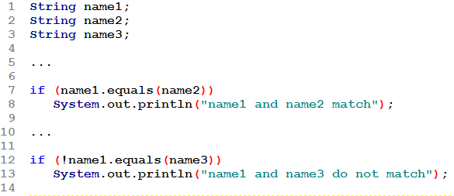
Comparing String Objects: equals
The equals method returns a boolean: true when the Strings match, false otherwise.
See example: StringCompare.java
3-<number>
Notes:
CHAPTER 3
Java Gaddis 4e

Slide 69
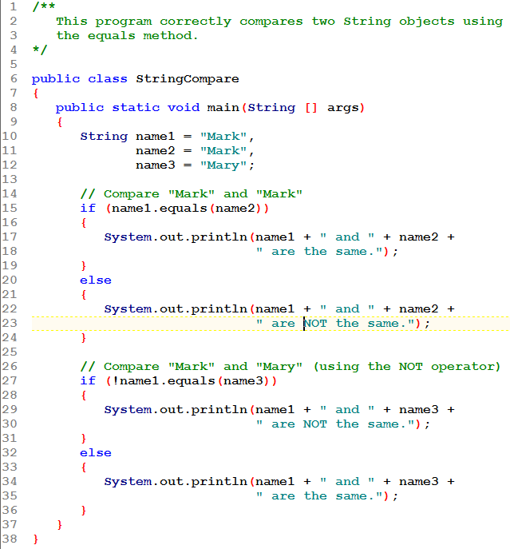
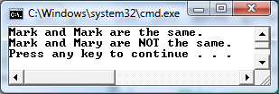

Slide 70
Comparing String Objects: compareTo
The compareTo method returns an int:
  int result = str1.compareTo(str2)
  result is less than 0 when str1 is less than (comes before) str2
  result is 0 when str1 matches str2
  result is greater than 0 when str1 is greater than (comes after) str2
This allows you to determine the order in which the Strings belong, important in sorting Strings.
See example: StringCompareTo.java
3-<number>
Notes:
CHAPTER 3
Java Gaddis 4e

Slide 71
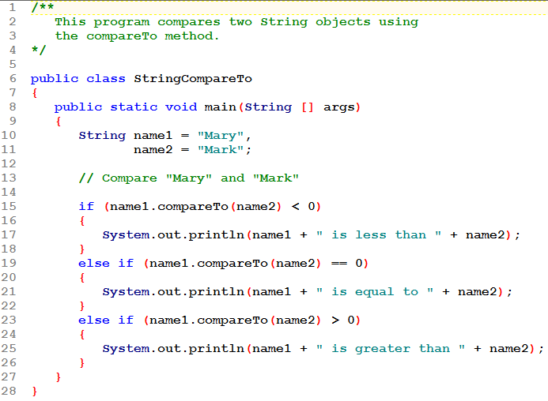
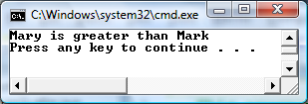
n1.compareTo(n2) < 0 when n1 comes before n2
n1.compareTo(n2) == 0 when n1 matches n2
n1.compareTo(n2) > 0 when n1 comes after n2

Slide 72
Ignoring Case in String Comparisons
In the String class the equals and compareTo methods are case sensitive.
In order to compare two String objects that might have different case, use:
  equalsIgnoreCase, or
  compareToIgnoreCase
See example: SecretWord.java
3-<number>
Notes:
CHAPTER 3
Java Gaddis 4e

Slide 73
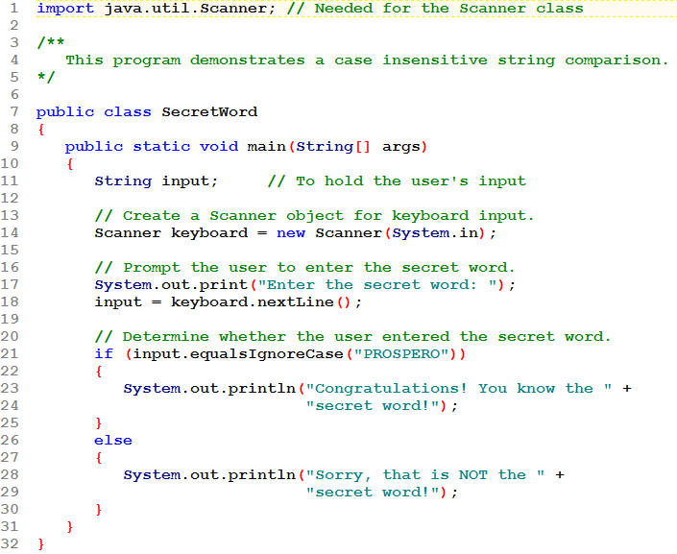
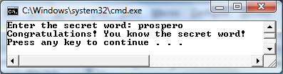

Slide 74
Variable Scope
In Java, a local variable does not have to be declared at the beginning of the method.
The scope of a local variable begins at the point it is declared and terminates at the end of the method.
When a program enters a section of code where a variable has scope, that variable has come into scope, which means the variable is visible to the program.
See example: VariableScope.java
3-<number>
Notes:
CHAPTER 3
Java Gaddis 4e

Slide 75
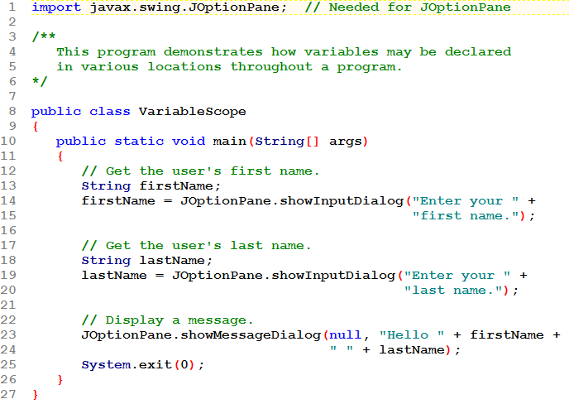
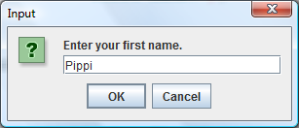
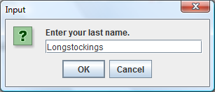
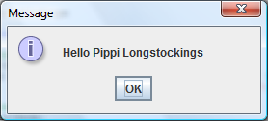

Slide 76
The Conditional Operator ?:
This is a form of selection that uses an operator to make a choice.
The conditional operator is a ternary (three operand) operator.
You can use the conditional operator to write a simple statement that works like an if-else statement.
3-<number>
Notes:
CHAPTER 3
Java Gaddis 4e

Slide 77
The Conditional Operator ?:
The format of the operators is:
  (BooleanExpression ? Value1 : Value2)
This forms a conditional expression.
If BooleanExpression is true, the value of the conditional expression is Value1.
If BooleanExpression is false, the value of the conditional expression is Value2.
Parentheses are not always required but often used.
3-<number>
Notes:
CHAPTER 3
Java Gaddis 4e

Slide 78
The Conditional Operator ?:
Example: This expression has one of 2 values:
( x > 10 ? 5 : 9 )
  When x > 10 is true the value is 5
  Otherwise, the value is 9.
It can be used in a statement such as:
  a = ( x > 10 ? 5 : 9 );
  Assign a new value to a: when x > 10 is true,
  a ← 5; otherwise, a ← 9
Notes:
Java Gaddis 4e
CHAPTER 3

Slide 79
The Conditional Operator ?:
Example:
  z = ( x > y ? 10 : 5 );
This line is functionally equivalent to:
  if (x > y)
  z = 10;
  else
  z = 5;
Warning: this is not correct syntax in Java
( x > y ? z = 10 : z = 5 ); // NO!
3-<number>
Notes:
CHAPTER 3
Java Gaddis 4e

Slide 80
The Conditional Operator ?:
This is used in statements in various ways:
  max = ( a > b ? a : b );
    When a > b is true, max ← a; otherwise max ← b
    Translation: assign the larger of a and b to max.
  str = "John "
  + ( age >= 21 ? "does" : "does not" )
  + " get a drink!";
    When age >= 21, str is "John does get a drink!"
    Otherwise, str is "John does not get a drink!"
3-<number>
Notes:
CHAPTER 3
Java Gaddis 4e

Slide 81
The Conditional Operator ?:
This is used in statements in various ways:
  avg = ( count == 0 ? 0.0 : total / count );
    Avoid division by 0; assign avg ← 0.0 when count is 0;
    otherwise avg ← total / count.
It really doesn't do anything you can't do with an if statement; the advantage is how compact the code can be. Try this with an if:
  strTime = ( hour < 10 ? "0" : "" ) + hour + ":"
  + ( min < 10 ? "0" : "" ) + min;
    hour = 5, min = 9, strTime is: 05:09
    hour = 10, min = 5, strTime is: 10:05
See example: ConsultantCharges.java
Notes:
Java Gaddis 4e
CHAPTER 3

Slide 82
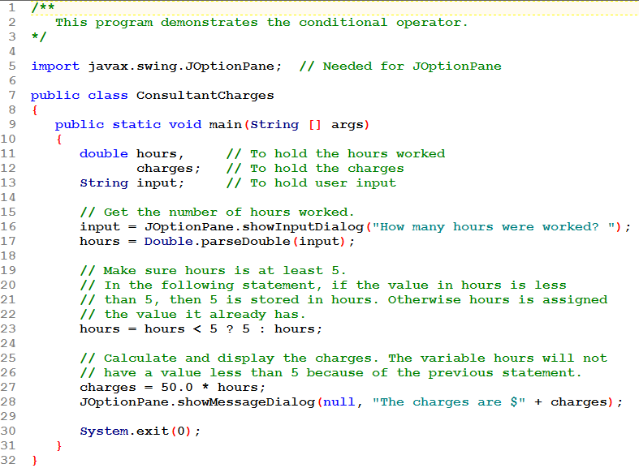
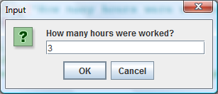
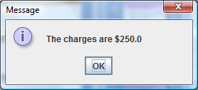

Slide 83
The switch Statement
The if-else statement allows you to make true / false branches.
The switch statement allows you to use an ordinal value to determine how a program will branch.
The switch statement can evaluate an integer type or character type variable and make decisions based on the value.
3-<number>
Notes:
CHAPTER 3
Java Gaddis 4e

Slide 84
The switch Statement
The switch statement takes the form:
  switch (SwitchExpression)
  {
  case CaseExpression:
  // place one or more statements here
  break;
  case CaseExpression:
  // place one or more statements here
  break;
  // case statements may be repeated
  //as many times as necessary
  default:
  // place one or more statements here
  }
3-<number>
Notes:
CHAPTER 3
Java Gaddis 4e

Slide 85
The switch Statement
The switch statement takes an ordinal value (byte, short, int, long, or char) as the SwitchExpression.
  switch(SwitchExpression)
  {
  …
  }
The switch statement will evaluate the expression.
If there is an associated case statement that matches that value, program execution will be transferred to that case statement.
Otherwise, execution will be transferred to the default statement, if there is one.
3-<number>
Notes:
CHAPTER 3
Java Gaddis 4e

Slide 86
The switch Statement
Each case statement will have a corresponding CaseExpression that must be unique.
  case CaseExpression:
  // place one or more statements here
  break;
If the SwitchExpression matches the CaseExpression, the Java statements between the colon and the break statement will be executed.
3-<number>
Notes:
CHAPTER 3
Java Gaddis 4e

Slide 87
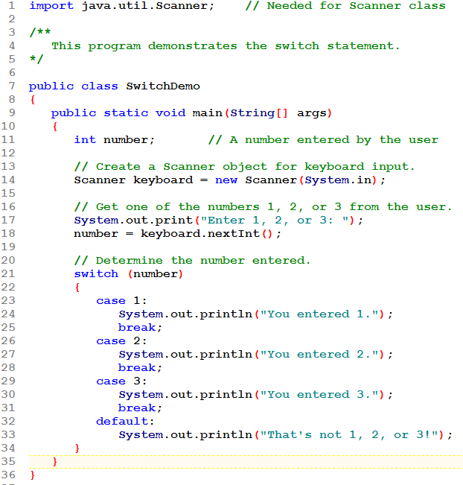
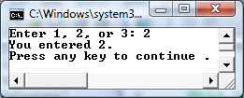
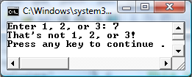

Slide 88
The switch Statement
Problem: User enters a number indicating whether to see the sum (1), difference (2), or product (3) of two previously determined numbers.
  Using the if statement, write the Java code that would assign to variable z either x + y, x – y, or x * y, depending on the user's choice.
Notes:
Java Gaddis 4e
CHAPTER 3

Slide 89
The switch Statement
// read choice
if ( choice == 1 ) // add
{
z = x + y;
}
else if ( choice == 2 ) // subtract
{
z = x – y;
}
else if ( choice == 3 ) // multiply
{
z = x * y;
}
else // invalid choice
{
// display error message
z = 0;
}
Solution using nested if statements.
Notes:
Java Gaddis 4e
CHAPTER 3

Slide 90
The switch Statement
Solution using a switch
// read choice
switch( choice ) // the switch expression
{
case 1: // add
z = x + y;
break;
case 2: // subtract
z = x – y;
break;
case 3: // multiply
z = x * y;
break;
default: // invalid choice
// error message
z = 0;
break;
}
break; is used here or else execution will continue into the next section of code.
break; is NOT required here since we are at the bottom of the switch.
Notes:
Java Gaddis 4e
CHAPTER 3

Slide 91
The switch Statement
The break statement ends the case statement.
The break statement is optional.
If a case does not contain a break, then program execution continues into the next case.
  See example: NoBreaks.java
  See example: PetFood.java
The default section is optional and will be executed if no CaseExpression matches the SwitchExpression.
3-<number>
Notes:
CHAPTER 3
Java Gaddis 4e

Slide 92
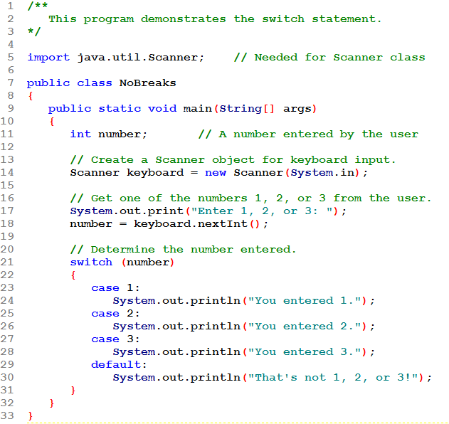
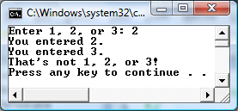
Missing a break: continues into the next case!

Slide 93
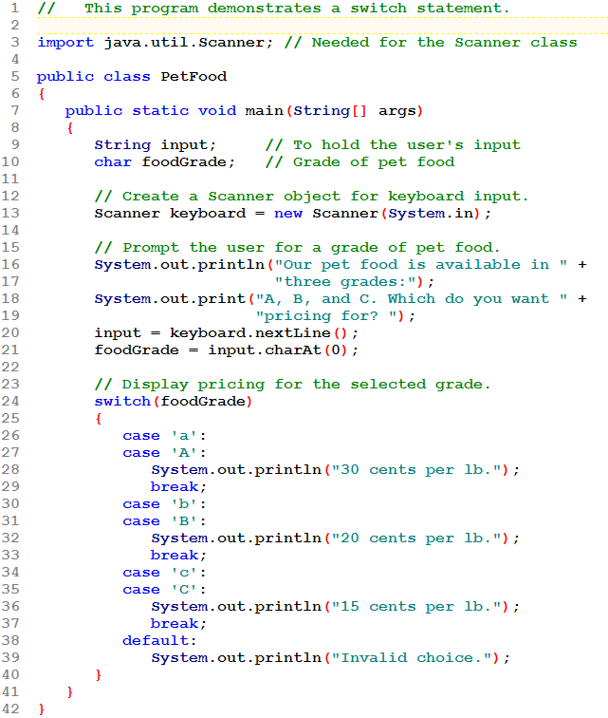
Notice how a single character is read!

Slide 94
Since there is no break after case 'a' control falls through into case 'A'. In this way, 'a' and 'A' are handled the same way without having to duplicate the statements.
This is the usual way to achieve the same action for more than one switch expression value.

Slide 95
The DecimalFormat Class
When printing out double and float values, the full fractional value will be printed.
The DecimalFormat class can be used to format these values.
In order to use the DecimalFormat class, the following import statement must be used at the top of the program:
import java.text.DecimalFormat;
3-<number>
Notes:
CHAPTER 3
Java Gaddis 4e

Slide 96
The DecimalFormat Class
The DecimalFormat class lets us format a number into many different String patterns.
First establish the "pattern":
DecimalFormat money =
new DecimalFormat( "$0.00" );
  when displayed will start with a $
  will have at least 1 digit before decimal pt
  will round to 2 places after decimal pt
Notes:
Java Gaddis 4e
CHAPTER 3

Slide 97
The DecimalFormat Class
Now use the "pattern":
System.out.println( money.format( x ) );
  money is the pattern
  uses the format method that takes a numeric argument and returns a String.
This does not change x itself; it just affects the way it is DISPLAYED.
There are many other patterns possible. See next slide.
Notes:
Java Gaddis 4e
CHAPTER 3

Slide 98
The DecimalFormat Class
If you use 0 on the left of the decimal point, it will put a digit (possibly 0) in that place:
  Example: "00" → will display as a whole number with at least two digits.
    0.76 → 01 // rounds
    125.3 → 125
    5 → 05
  Unless you want leading zeros, just use one 0 to the left of the decimal point.
  If you don't put any decimal places in the pattern, it will round to the nearest whole number.

Slide 99
The DecimalFormat Class
If you want to get commas displayed (numbers might be 1000 or larger), you just need to use a pattern that shows 1 comma. Use # as placeholders for digits. With leading # characters, leading zeros will be suppressed.
  Example: "#,##0.0" → will not have leading 0's; will have commas where needed; will round to 1 decimal place.
    34.56 → 34.6
    12345678 → 12,345,678.0
    .5 → 0.5

Slide 100
The DecimalFormat Class
If you are displaying money, just include a $ at the start of the pattern.
  Example: "$0.00" → will start with $; not have commas or leading zeros; will be rounded to 2 decimal places.
    234.768 → $234.77
    10000 → $10000.00
Don't forget, if you want commas in large numbers, you must put a comma into the pattern
  Example: "$#,##0.00" → as above, but with commas if needed
    234.768 → $234.77
    10000 → $10,000.00

Slide 101
The DecimalFormat Class
If you put a % on the end of the pattern, the value will be converted to a percent (multiplied by 100) and displayed with a % on the end.
  Example: "0.0%"
    0.3456 → 34.6%
    1 → 100.0%

Slide 102
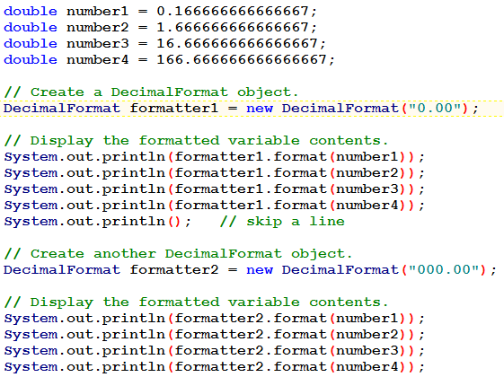
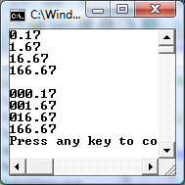

Slide 103
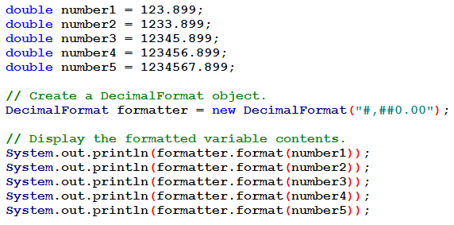
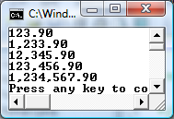
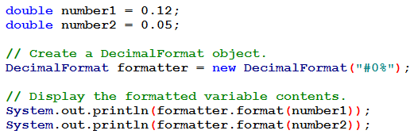
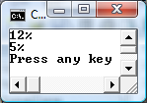

Slide 104
The printf Method
You can use the System.out.printf method to perform formatted console output.
The general format of the method is:
System.out.printf(FormatString, ArgList);
3-<number>
Notes:
CHAPTER 3
Java Gaddis 4e

Slide 105
The printf Method
System.out.printf(FormatString, ArgList);
FormatString is a string that contains text and/or special formatting specifiers.
ArgList is optional. It is a list of additional arguments that will be formatted according to the format specifiers listed in the format string.
3-<number>
Notes:
CHAPTER 3
Java Gaddis 4e

Slide 106
The printf Method
Format specifiers
  d decimal (base 10) integer value goes here
  f floating point value goes here. Will use 6
  decimal places.
  s String goes here
3-<number>
Notes:
CHAPTER 3
Java Gaddis 4e

Slide 107
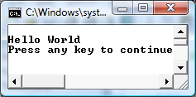
The printf Method
A simple example:
System.out.printf("Hello World\n");
3-<number>
Notes:
CHAPTER 3
Java Gaddis 4e

Slide 108
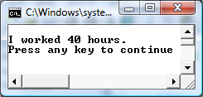
The printf Method
Another example:
int hours = 40;
System.out.printf("I worked %d hours.\n", hours);
3-<number>
Notes:
CHAPTER 3
Java Gaddis 4e

Slide 109
The printf Method
int hours = 40;
System.out.printf("I worked %d hours.\n", hours);
The %d format specifier indicates that a decimal integer will be printed.
The contents of the hours variable will be printed in the location of the %d format specifier.
3-<number>
Notes:
CHAPTER 3
Java Gaddis 4e

Slide 110
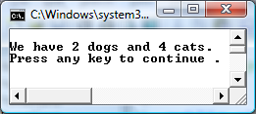
The printf Method
Another example:
int dogs = 2, cats = 4;
System.out.printf("We have %d dogs and %d cats.\n",
dogs, cats);
3-<number>
Notes:
CHAPTER 3
Java Gaddis 4e

Slide 111
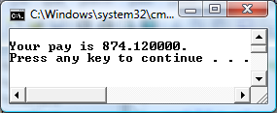
The printf Method
Another example:
double grossPay = 874.12;
System.out.printf("Your pay is %f.\n", grossPay);
3-<number>
Notes:
CHAPTER 3
Java Gaddis 4e

Slide 112
The printf Method
Another example:
double grossPay = 874.12;
System.out.printf("Your pay is %f.\n", grossPay);
The %f format specifier indicates that a floating-point value will be printed.
The contents of the grossPay variable will be printed in the location of the %f format specifier.
3-<number>
Notes:
CHAPTER 3
Java Gaddis 4e

Slide 113
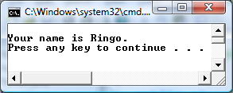
The printf Method
Another example:
String name = "Ringo";
System.out.printf("Your name is %s.\n", name);
The %s format specifier indicates that a string will be printed.
3-<number>
Notes:
CHAPTER 3
Java Gaddis 4e

Slide 114


The printf Method
Field width: use a whole number
  display the value using this number of characters
  right align, padding with leading spaces
  if it's not large enough, the field width will be expanded as needed
The *'s in these examples are only to show the extent of a field, including leading/trailing spaces. You would not use the *'s!
3-<number>
Notes:
CHAPTER 3
Java Gaddis 4e

Slide 115

The printf Method
Specifying a field width:
int number = 9;
System.out.printf("The value is %6d\n", number);
The %6d format specifier indicates the integer will appear in a field that is 6 spaces wide.
3-<number>
Notes:
CHAPTER 3
Java Gaddis 4e

Slide 116


The printf Method
Field width: use a whole number
  can be used with Strings
  make it a negative number to left-align, with trailing spaces
3-<number>
Notes:
CHAPTER 3
Java Gaddis 4e

Slide 117


The printf Method
Field width: use a whole number
  can be used with Strings
  make it a negative number to left-align, with trailing spaces
3-<number>
Notes:
CHAPTER 3
Java Gaddis 4e

Slide 118


The printf Method
Precision: use a decimal to say how many places to display (it will round as specified).
3-<number>
Notes:
CHAPTER 3
Java Gaddis 4e

Slide 119

The printf Method
Another example:
double value = 874.215;
System.out.printf("The value is %.2f.\n", value);
3-<number>
Notes:
CHAPTER 3
Java Gaddis 4e

Slide 120

The printf Method
Precision and Field Width can be combined.
  In addition, put a comma after the % and commas, as needed, will be inserted into a large value.
3-<number>
Notes:
CHAPTER 3
Java Gaddis 4e

Slide 121

The printf Method
Another example:
double number = 9.76891;
System.out.printf("The value is %6.2f\n", number);
The %6.2f format specifier indicates the number will appear in a field that is 6 spaces wide, and be rounded to 2 decimal places.
3-<number>
Notes:
CHAPTER 3
Java Gaddis 4e

Slide 122
END CHAPTER 3

